Slide 1

THE FACTORS THAT AFFECT THE TOTAL NUMBER OF SALES FOR STEAM GAMES
PRESENTED TO: Dr. Chaklam Supawilachai
ITE224-Data Science
OLIVIA PARRY : 215210064
ATTAHPHOL KUKREJA : 215210032
PONGSAKORN TANUPATRASAKUL : 1702060008

Slide 2

Introduction
We are analysing Steam sale data in order to find out some of the reasons why some games sell (have the most players) more than others.
What kind of factors will affect game sales for games on Steam?

Slide 3
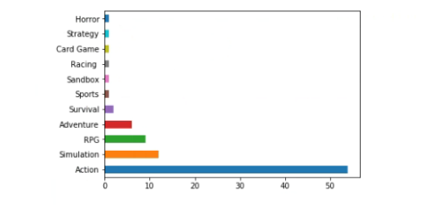
Genre Barchart
The results show that the data we got were mostly an action game.

Slide 4
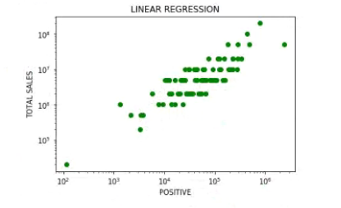
Positive Review vs Total Sale

Slide 5
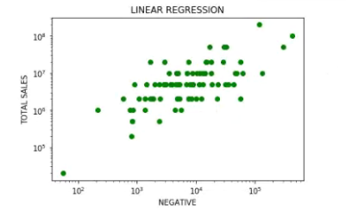
Negative Review vs Total Sale

Slide 6
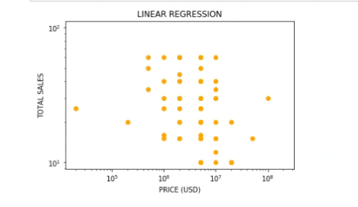
Game Price vs Total Sale

Slide 7
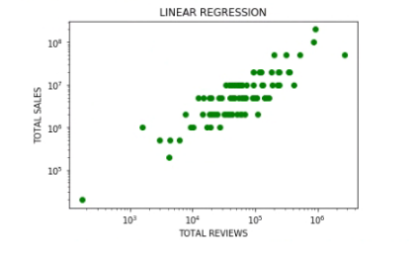
Total Review vs Total Sale

Slide 8
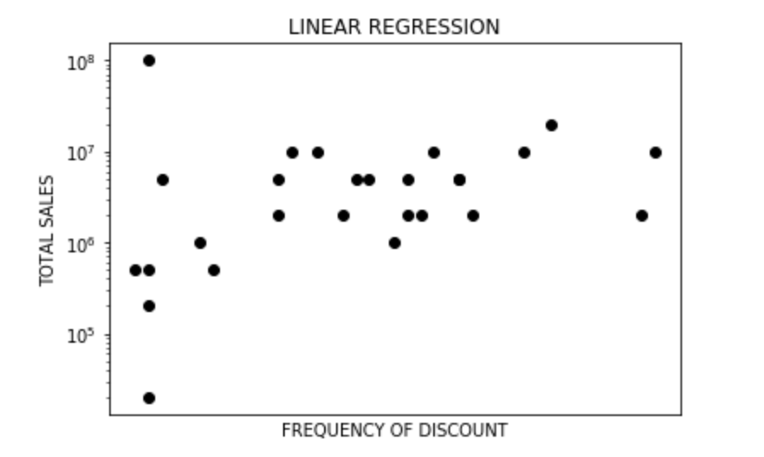
Discount Event vs Total Sale

Slide 9

Limitation
Steam don’t release this data
Manual input of data
Inadequate knowledge on Python

